Slide 1

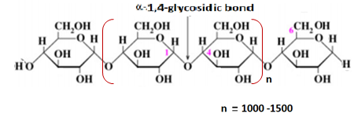
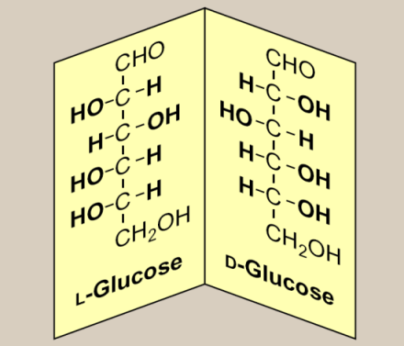
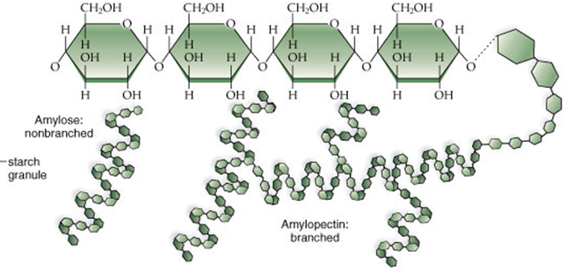
CHM 122 INTRODUCTORY ORGANIC CHEMISTRY (2 UNITS)
MODULE 11:
INTRODUCTION TO
CHEMISTRY OF MACROMOLECULES

Slide 2
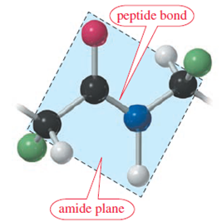
OBJECTIVES
To recognize the existence and significance of macromolecules.
To identify the structures of various types of macromolecules.
To identify the classifications of macromolecules.
To distinguish between mono-, oligo-, and poly- saccharides.
To distinguish between amino acids, peptides, and proteins.

Slide 3
Keywords
Conformation = the shape or structure of a compound or substance.
Repeating unit = the recurring structural unit on a polymer chain structure.
Monomer = the building block of polymers which usually stands as the recurring unit (repeating unit).
Polymer = a giant molecule with heavy molecular weight, formed by the covalent linkages of thousands of small molecules called the monomers.
Chiral carbon = a tetrahedral carbon that is attached to four different groups.
Significance = importance
Biochemical functions = chemical processes that occur in living organisms e.g. photosynthesis.
Covalent bonding = a strong form of bond existing in a molecule, which is formed between two atoms or groups through electron - sharing.
Optical isomers = two molecules with same formula but can rotate plane of polarized light in opposite directions and are termed as D and L –isomers.

Slide 4
INTRODUCTION
Macromolecules are large molecules, most of which are carbon compounds.
On the structural basis, macromolecules can be of two types:
Polymers: those giant molecules that are made up of multiple repeating units e.g. polyethylene.
Macromolecules: those large molecules containing no repeating unit e.g. chlorophyll.
Thus polyethylene or polyethene as known otherwise, is simultaneously a polymer and macromolecule while chlorophyll is just a macromolecule but not a polymer.

Slide 5
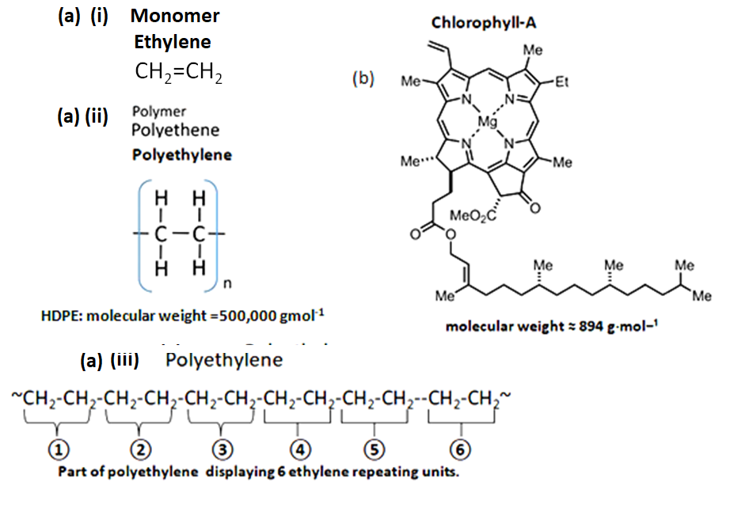
Notes:
Note: polyethylene is both a polymer and macromolecule but chlorophyll is a macromolecule but not a polymer.
Question: All polymers are macromolecules but not all macromolecules are polymers. Explain.
Note: Polyethylene formed via the linkage of large number of ethylene repeating units.
Question: All polymers are macromolecules but not all macromolecules are polymers. Explain..

Slide 6
According to source of availability macromolecules occur both naturally and synthetically.
Natural macromolecules: Naturally occurring macromolecules are of great significance in nature as they form part of living organisms carrying out some important biological functions within the body system (plants and animals) e.g. carbohydrates, lipids (fats and oils), proteins and nucleic acids (such as RNA and DNA). For example enzymes which catalyzes biochemical reactions are proteins.
Synthetic macromolecules: These synthetic compounds are of great industrial significance and include materials like plastics, both thermoplastics and thermosetting materials such as bakelite, melamine and some polyester resins.

Slide 7
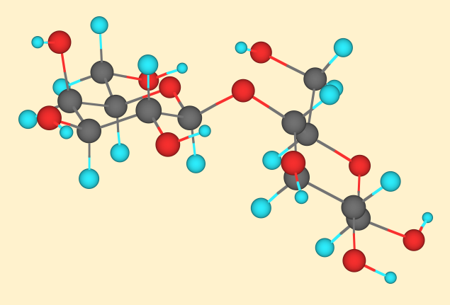
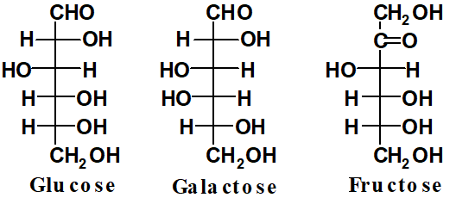
Carbohydrates
Carbohydrates are polyhydroxyaldehydes, polyhydroxyketones, or any compound that gives either of these compounds after hydrolysis (e.g. sucrose). Carbohydrates or sugars have the general formula C_{n}(H₂O)_{n} or C_{n}H_{2n}O_{n} and as a result they are called hydrated carbon or as more commonly known , carbohydrates.
Carbohydrates are basically classified into monosaccharides, trisaccharides, oligosaccharides, and polysaccharides.
Notes:
Note : C_{n}(H₂O)_{n} or C_{n}H_{2n}O_{n} stands as a general formula for monosaccharides.

Slide 8
Monosaccharides: a carbohydrate that contains only one monomer of simple sugar is called monosaccharide.
Disaccharides: a carbohydrate that contains two monosaccharides is called disaccharide.
Trisaccharides: a carbohydrate that contains three monosaccharides is called trisaccharide.
Oligosaccharides: those carbohydrates containing 4 to 10 monosaccharides are generally called oligosaccharides
Polysaccharides: those carbohydrates with large number of monosaccharide monomer units are termed as polysaccharides. Examples of polysaccharides include starch and cellulose.

Slide 9
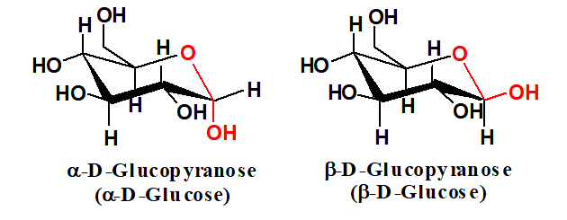
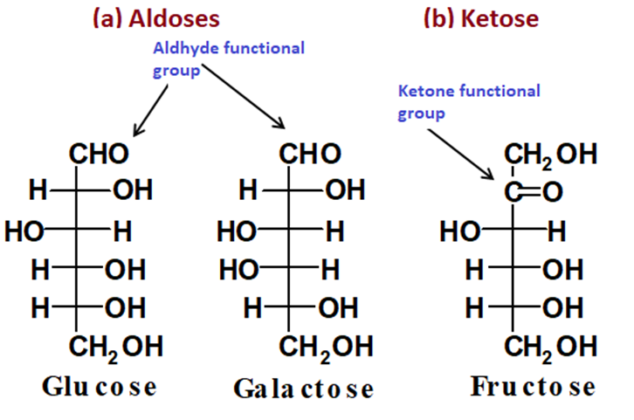
Monosaccharide:
Monosaccharides or simple sugars are the monomers from which more complex sugars such as sucrose and starch are produced. A monosaccharide is a carbohydrate that cannot be hydrolyzed to a simpler carbohydrate. They have the general formula C_{n}H_{2n}O_{n}, where n varies from 3 to 8.
The most commonly encountered monosaccharide is glucose (C₆H₁₂O₆) also known as dextrose or blood sugar.
Monosaccharides with aldehyde group are called aldoses while those with ketone group are termed as ketoses.
Besides aldehyde and ketone forms, these saccharides can also exist in a cyclic form.

Slide 10
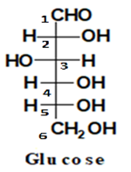
The Cyclization Process
A reversible reaction occurs in which a hydrogen atom is moved from the hydroxyl group (-OH) to the carbonyl oxygen to form an ether bond between the two carbons involved.
In the process, a ring is also formed and carbon atom 1 becomes chiral. The chiral center can exist as either of two isomers, and the resulting stereoisomers are termed as alpha- or beta- form of structures.
We can also notice from the linear form of glucose that carbon 2, 3, 4 and 5 each have four different groups attached to it and are therefore chiral carbons.
Notes:
Carbon 1 and 6 are non chiral as carbon 1 carries only three groups while carbon 5 carries two similar gropus (hydrogen atoms).

Slide 11
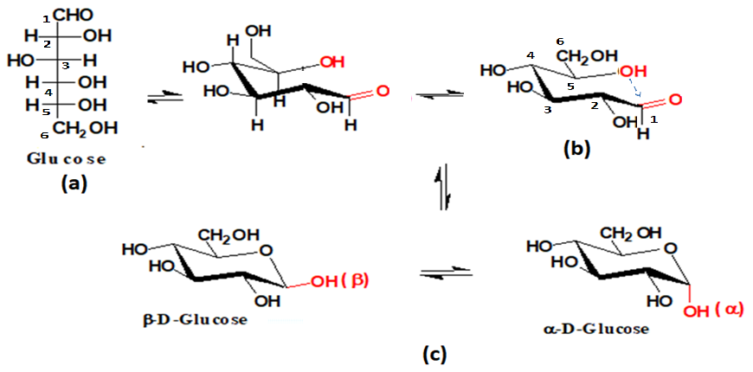
We can also explain the same glucose cyclization process using chair conformation.
(a) Shows glucose structure in its aldehyde form.
(b) Shows glucose molecule rotated into conformation that brings the hydroxyl group (-OH) of carbon 5 near aldehyde carbon.
(c) Shows the two cyclic forms of glucose with (i) –OH at axial position, and (ii) -OH at equatorial (horizontal) position.

Slide 12
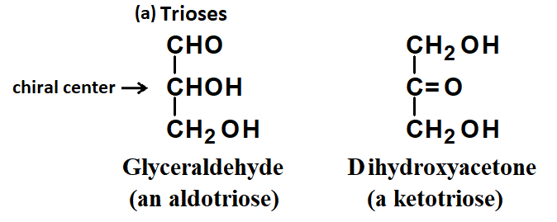
Another criterion followed for the classification of monosaccharides is based upon the number of carbon atoms contained within such sugar molecules.
On this basis, compounds are simply referred to as trioses, tetroses, and so forth telling the number of carbon atoms present. However, the most important simple sugars contain either five or six carbon atoms. These sugars are generally referred to as pentoses and hexoses respectively.

Slide 13
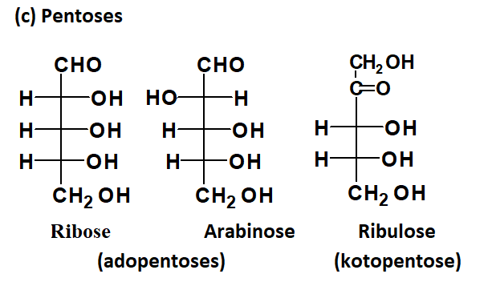
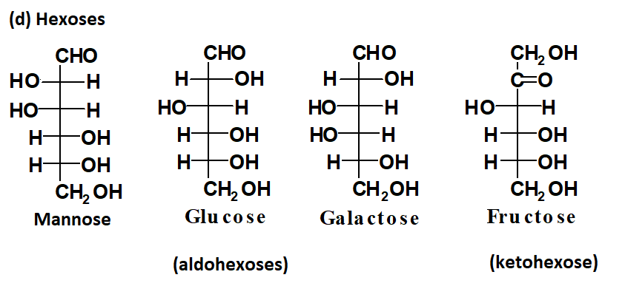
Parts of the most abundant pentoses and hexoses include the following structures:

Slide 14
D,L Monosaccharides
In 1891, Emil Fischer made the arbitrary assignments of D- and L- to the enantiomers of glyceraldehyde as two optical isomers can be found with each of such monosaccharide structures. According to the conventions proposed by Fischer:
D-monosaccharide: A monosaccharide that has the same configuration at its penultimate (next to bottom) carbon as D- glyceraldehyde; that is, its -OH is on the right when written as a Fischer projection.
L-monosaccharide: A monosaccharide that has the same configuration at its penultimate carbon as L- glyceraldehyde; that is, its -OH is on the left when written as a Fischer projection.

Slide 15
Disaccharides
A Disaccharide incorporates two monosaccharide molecules within its chemical structure.
The following combinations lead to formation of larger molecules, known as disaccharides which form through what is known as glycosidic bond.
glucose + fructose = sucrose
glucose + glucose = maltose
glucose + galactose = lactose

Slide 16
Most of the naturally occurring carbohydrates contain more than one monosaccharide units.
Complex sugars are formed when two or more monosaccharides are linked to develop a larger molecule.
This linkage between each two monosaccharides occurs by the elimination of water molecule to form an ether bond (C-O) known as glycosidic bond. For example, sucrose is formed from formation of glycosidic bond between alpha-glucose and beta-fructose.
Note: Fructose is a ketone - containing monosaccharide that can exist in a cyclic form. The cyclization involves carbon 2 and 5 instead of 1 and 5 since the carbonyl carbon (C=O) occurs as carbon two unlike in aldoses where carbonyl carbon (C=O) always maintains position 1.
The C-O-C linkage in disaccharides that forms between two molecules of monosaccharides, involves carbon 1 or 2 of one monosaccharides and carbon 1, 2, 4, or 6 of the other monosaccharide.

Slide 17
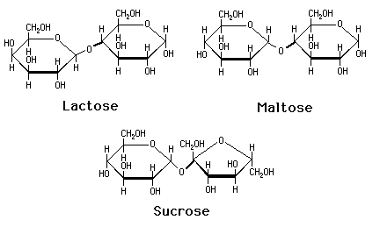
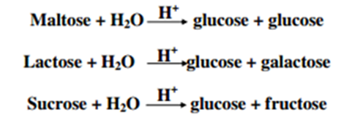
The three common disaccharides include lactose, sucrose and maltose all of which have the same molecular formula but differ in their formula structure.
This is to say that disaccharide can always be hydrolyzed back to the individual monomer units from which the sugars are made. In other words, disaccharides can be hydrolyzed (addition of water molecule) into a simpler carbohydrate.

Slide 18
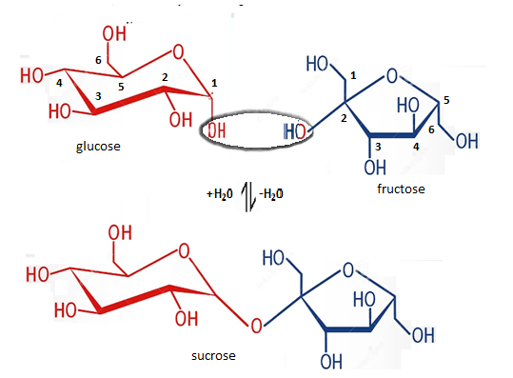
Sucrose is a common table sugar which is a sweet white crystalline solid that is widely used as food additive.
Sucrose is made up of the two simple sugars glucose and fructose which are joined together by a chemical bond known as a glycosidic bond.
Note: when a hydroxyl group (-OH) in one monosaccharide reacts with another hydroxyl group of another monosaccharide a glycosidic bond (C-O) is forms and the product is a disaccharide. However, this reaction is reversible through hydrolysis.

Slide 19
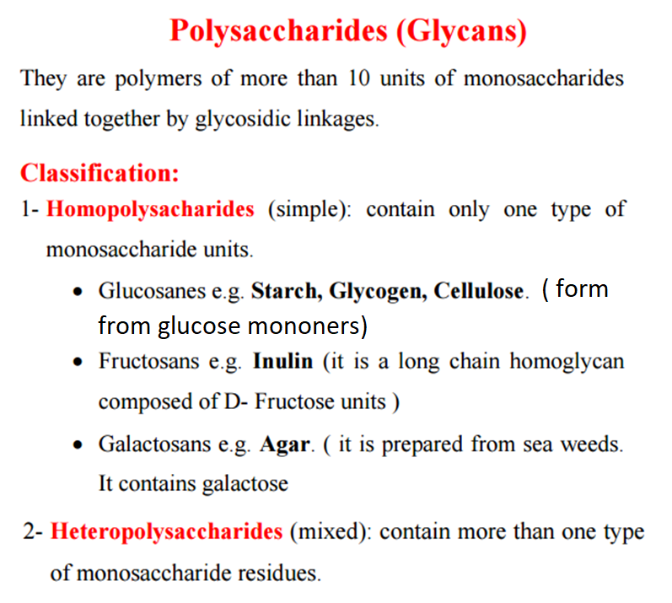

Slide 20
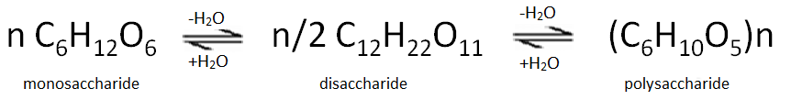
Starch
Starch is a polysaccharide with relative molecular mass of 15000 to 300,000 made up of repeating glucose units linked together to form a giant branched or unbranched molecule. Starch occur naturally in most plants as a storage carbohydrate for example in maize (corn), cassava, yam and cocoyam tuber, potatoes, rice, wheat barley and other cereals.
Starch contains entirely alpha (+)–glucose units linked via carbon 1 and carbon 4 atoms and/or carbon 1 and carbon 6 atoms. Starch does not reduce Fehling’s solution, Tollen’s reagent or ammoniacal silver(I)nitrate, nor does it form an osazone with phenyl hydrazine.
Starch forms an intense dark blue substance with iodine, and the colour disappears on warming but reappears on cooling. This provides a sensitive test for both iodine and starch.
The relationship between mono-, di-, and poly-saccharides is represented by the chemical equation below:

Slide 21
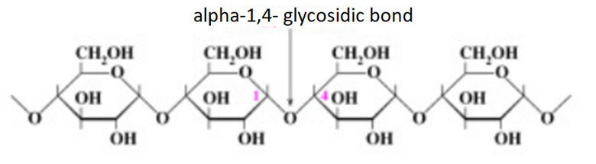
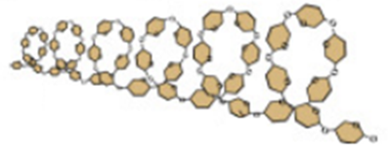
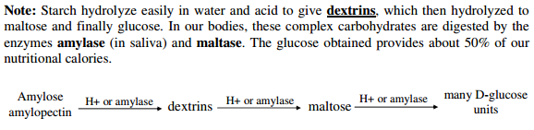

Slide 22
PROTEINS AND PEPTIDES
Amino Acids are the building units of proteins. Proteins are polymers of amino acids linked together by what is called “ peptide bond”.
Amino acids are recognized as monomers of both peptides and polypeptides or proteins.
Two amino acids molecules can react through amide bond called the peptide bond to form a larger compound. A compound formed by the linkage of small number of amino acid is called peptide. Prefixes di-, tri-, tetra-, and so on could be used to indicate the number of amino acid monomer contained within peptides. Peptide bond forms when the acid group (COOH) of one amino acid joins with the amine group (NH₂) of a second amino acid.
Formed through condensation
Broken through hydrolysis
However, when large number of amino acids linked to form a giant molecule, such molecules are referred to as proteins.

Slide 23
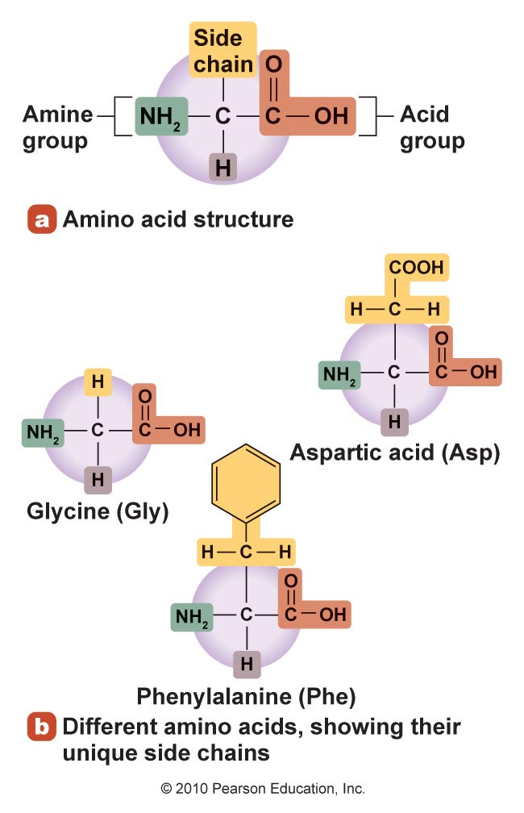
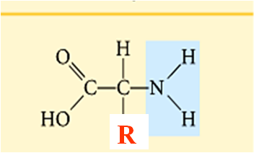
Structure of Amino Acids:
There are about 300 amino acids occurring in nature. Only 20 of them occur in proteins. These twenty different alpha- amino acids are found widely in nature and are often referred to as “the mighty twenty”. Each acid is commonly given a three letter abbreviation e.g. “Val” for Valine. These acid have a general structure as represented below:
Each amino acid has 4 different groups attached to α- carbon ( which is C-atom next to –COOH group). These 4 groups are: amino group (-NH₂), Carboxylic acid group (-COOH), hydrogen atom (H) and a side chain (R).
The side chain (R) varies from one amino acid to another leading to differences in the properties of alpha-amino acids.

Slide 24
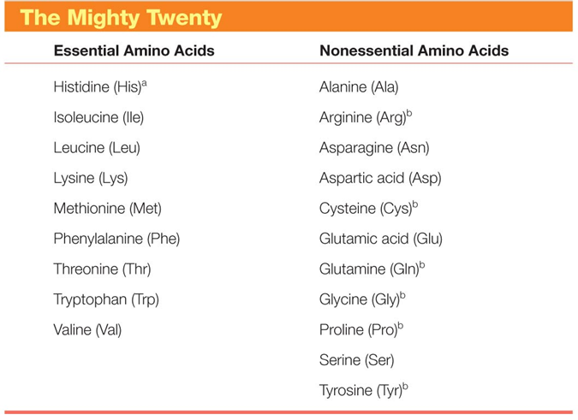
Table 1

Slide 25
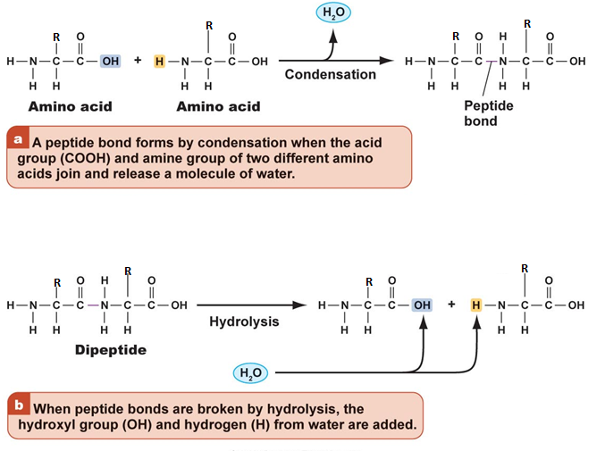
Condensation and Hydrolytic Reactions
Prefixes di-, tri-,and so on are used to indicate the number of amino acid monomers that are joint to form peptides, and the amide bond linking the amino acid monomers is called peptide bond.

Slide 26
Applications of Peptides
Many small peptides are known to have physiological significance.
Table 2
Peptide | Type | Application
Aspartame | Dipeptide | Serves as common sweetener.
Glutathione | Tripeptide | Stands as a scavenging agent for harmful oxidizing agents. It is believe to cause cancer.
Enkephalins | Pentapeptides | Stand as a group of naturally occurring analgesics (pain relievers) that occur in the brain.
Gramicidin- S | Cyclic decapentide | Serves as antibiotics.
Tyrocidin- A | Cyclic decapentide | Serves as antibiotics.
Notes:
A cyclic decapentide contains ten amino acids linked into a ring by peptide bonds. Gramicidin- S and Tyrocidin- A are produces by certain bacterium.

Slide 27
Classification of Amino Acids
Amino acids are usually classified according two criteria.
The first classification depends on whether the R groups are polar or non polar chains.
The second classification is based on whether R group contains acidic or basic group.

Slide 28
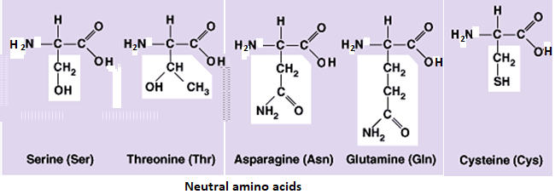
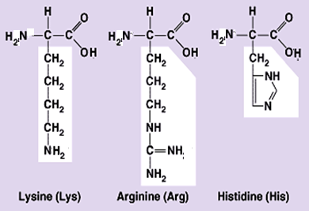
Neutral amino acids: Have equal amount of carboxylic and amino groups.
B- Basic amino acids: Contain two or more NH₂ groups or nitrogen atoms that act as base i.e. can bind proton.

Slide 29
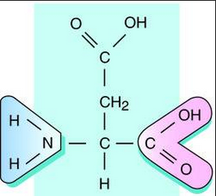
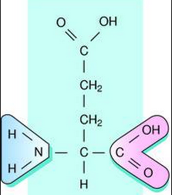
C- Acidic Amino acids: Contain two or more –COOH groups that act as acid i.e. can donate proton. At physiological pH will carry negative charge. e.g. Aspartic acid (aspartate) and Glutamic acid (glutamate).
Asparagine and Glutamine: They are amide forms of aspartate and glutamate in which side chain COOH groups are amidated. They are classified as neutral amino acids.
Aspartic acid Glutamic acid

Slide 30
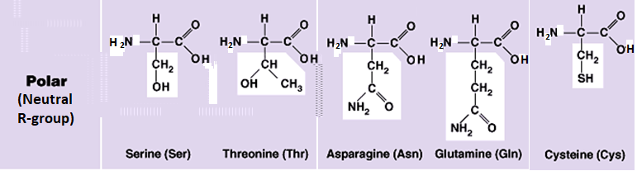
II- Classification according to polarity of side chain (R):
A- Polar amino acids: in which R contains polar hydrophilic group so can forms hydrogen bond with H₂O. In those amino acids, R may contain:
B- Non polar amino acids:
R is alkyl hydrophobic group which can’t enter in hydrogen bond formation.

Slide 31
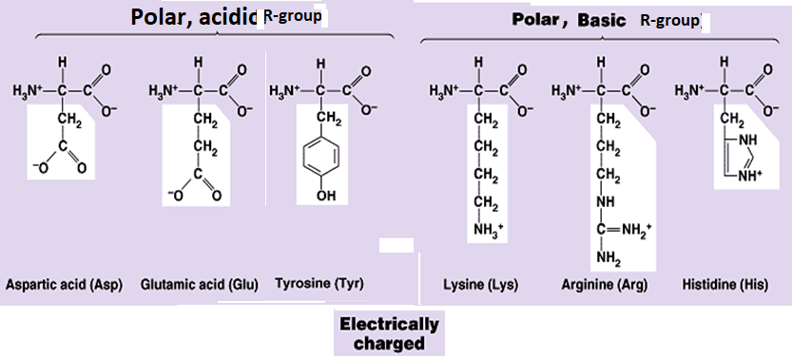
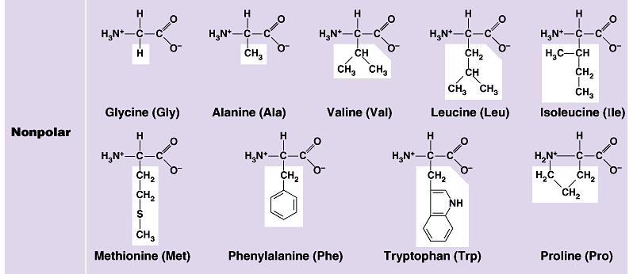

Slide 32
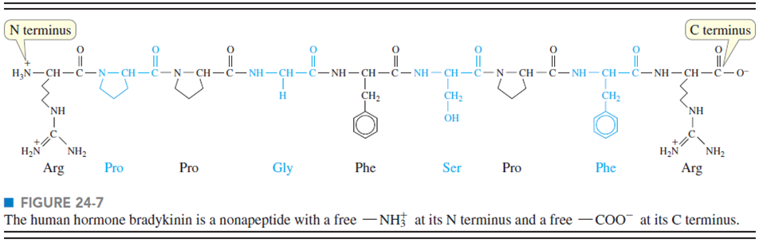
Proteins
A protein is a biopolymer of molecular weight typically of 5000 g/mol or greater, and is made up of one or more polypeptide chains.
The alpha-amino acids that occurs in nearly all proteins are L optical isomers.

Slide 33
Functions of Proteins
Proteins make up more than 50 % of the dry weight of animals and bacteria. Proteins perform so many important functions in living organisms a few of which are indicated in table below. Each protein carries out a specific biochemical function. For example, an enzyme is a protein that catalyses a biochemical reaction. Each enzyme is having a specific function.
Table 3: Functions of some proteins
Class | Example | Function
Enzymes | amylase | Converts starch to glucose
 | DNA polymerase I | Repairs DNA molecule
 | Trans amine | Transfer amino group from one amino acid to another
Structural proteins | Viral coat protein | Outer covering of virus
 | keratin | Hairs, nails, horns, hoofs
 | collagen | Tendons, cartilage
Hormones | Insulin, glucagon | Regulates glucose metabolism
 | oxytocin | Regulates milk production in mammals
 | vasopressin | Increase retention of water by kidney
Contractile proteins | aucin | Thin contractile filaments in muscle
 | myosin | Thick filaments in muscle
Storage proteins | casein | A nutrient protein in milk
 | ferritin | Stores iron in spleen and egg yolk

Slide 34
Structures of Proteins
Primary structure: Each protein consists of one or more polypeptide chains with unique sequence of amino acids. The order of sequence of amino acids monomers on the polypeptide chain of a protein, is termed as the primary structure of such protein.
Secondary structure: The many possible interactions between different amino acids in the polypeptide chain cause each protein molecule to adopt a characteristic shape, usually depending on its environment. The secondary structure of protein is the arrangement in space of the polypeptide backbone, without reference to conformations of the side chain (R). In general proteins fold into two broad classes of structure termed, globular proteins and fibrous proteins. Globular proteins are compactly folded and coiled, whereas, fibrous proteins are more filamentous or elongated. It can be helices, sheets, turns/loops e.g. Myoglobin is referred to as globular protein.
Tertiary structure: A tertiary structure of protein describes the overall shape of the protein, including side chain and any other non-peptide components of proteins.
Quaternary structure: Some proteins consists of multiple polypeptides units called subunits which are held together by non covalent interactions such as hydrogen bonding, dipole-dipole interactions or ionic attractions to form a quaternary structure of protein.

Slide 35
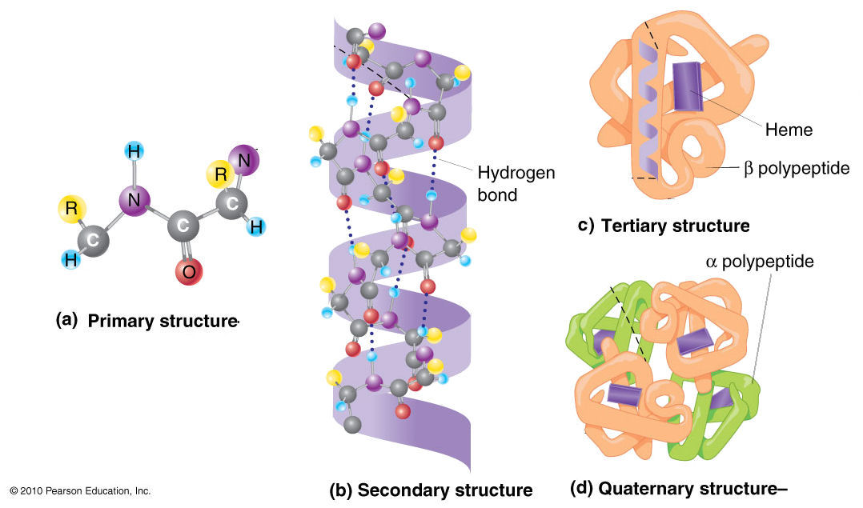
References

Slide 36
Thank You

